Slide 1
Ddos Botnet Testing scenario
A Structured Approach to Botnet Component Testing
André Filho - 2240617
Ricardo Pereira – 2240619

Slide 2
Introduction
Distributed Denial-of-Service (DDoS) attacks have become a major cybersecurity concern in today's interconnected world.
These attacks exploit networks of infected devices to overwhelm target servers, causing downtime and disruption.
Rise of botnets - networks of compromised devices controlled by malicious actors. They are used to execute large-scale attacks.

Slide 3
PROBLEM
Attack Strategies
Lack of Understanding the impact of various attack strategies (HTTP floods, TCP floods, etc.)
Complex Behavior
Analyzing how bots interact with C2 servers and targets requires a structured and controlled setup that mimics real attacks.
FINANCIALS
Global DDoS attacks are projected to cost businesses over $10 billion annually, with inadequate preparation leading to significant financial and reputational damage.
COSTS
Real-world botnet attacks cause downtime, loss of productivity, and operational disruption, costing organizations thousands of dollars per hour.

Slide 4
Project OVERVIEW
Objective
Create a safe and controlled environment for simulating and analyzing botnet behaviors, enabling detailed study without real-world risks.
Scope
Simulating botnet attacks in a structured framework.
Understanding bot-to-C2 server interactions and command execution.
Key Benefits
Avoids unintended disruptions in real-world environments.
Helps cybersecurity professionals understand botnet dynamics.
Easily configurable for different attack types and scenarios.
Core Components
Bots – C2 Server – Target Server

Slide 5
Botnet Testing Scenario

Slide 6
Components OVERVIEW
Operator (C2 Manager)
The individual responsible for managing and controlling the C2 server.
Command-and-control Server (C2)
The centralized hub for managing bots. Receives instructions from a human operator, queues commands, collects execution reports and monitors bot behavior in real-time.
Bots
Automated agents that execute commands fetched from the C2 server.
Target
The simulated victim infrastructure designed to log and analyze incoming traffic.

Slide 7
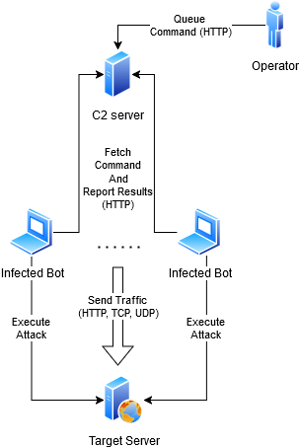
System Architecture
The previously discussed components integrate to simulate a small-scale botnet environment. Each bot is highly scalable, requiring only the initial propagation of the bot package through infection.

Slide 8
Environment Setup Requirements

Slide 9
System Setup Requirements
Bots
C2 Server
Target Server
Instalation of the AlaBouali Bane package. Will do the heavy lifting, providing multiple DoS attack scenarios.
pip instal bane
Flask - A lightweight web framework for Python.
pip install flask
Some sort of monitoring system, we chose Beszel
Donwload and run install-hub.sh from the official Beszel documentation

Slide 10
Component Functionalities

Slide 11
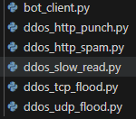
Bot – Package
To set up a new bot, the provided package must be deployed to a vulnerable device.
The process of exploiting vulnerabilities, transmitting, and running this package (e.g., through malware) is beyond the scope of this academic project.

Slide 12
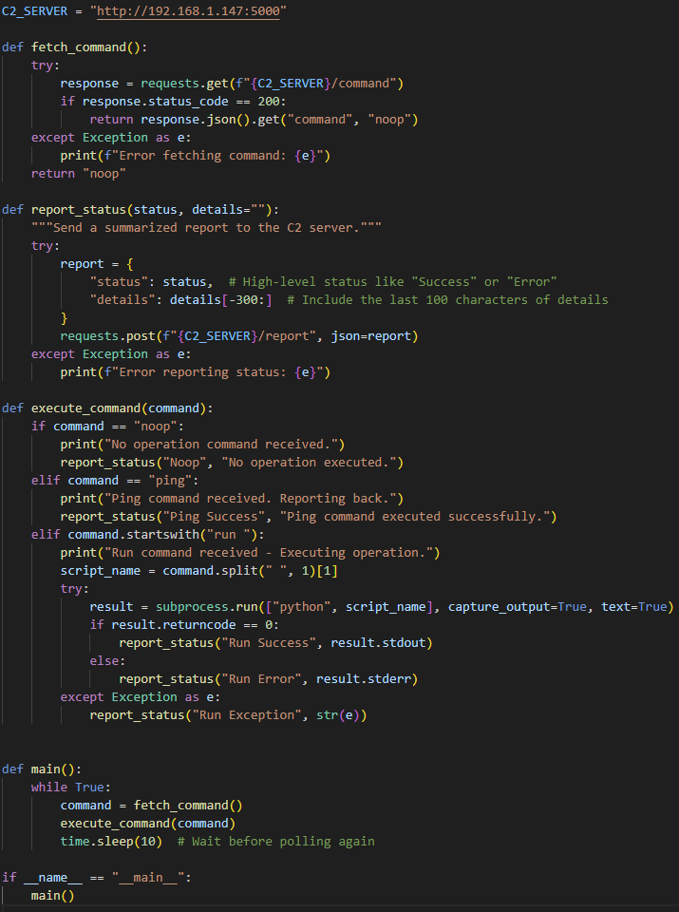
Bot – Server
Fetch commands periodically and report what command was found
If a command is found, call the execution of the respective python attack script
Report back to C2 server with the results

Slide 13
BOT – Implemented Attacks
HTTP Punch/Spam
TCP Flood
HTTP Punch sends fewer, large requests to overload the server with high-intensity traffic.
HTTP Spam floods the server with a high volume of lightweight requests, overwhelming its connection limits.
Sends numerous TCP connection requests to a target server.
UDP Flood
Slow read
Floods the server with a high volume of UDP packets.
Keeps HTTP connections open by reading responses very slowly.

Slide 14
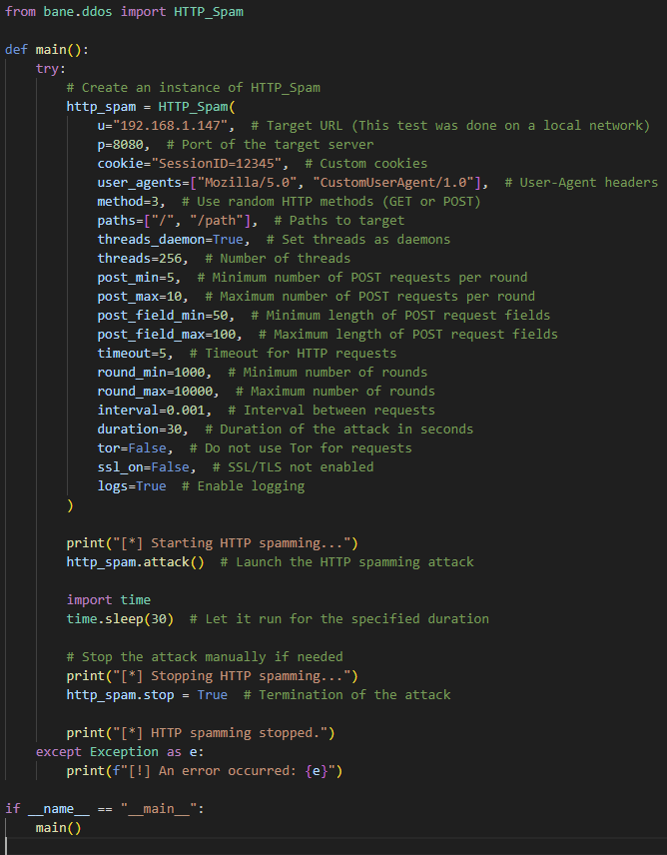
Bot – Attack Example (HTTP_SPAM)
Define Attack type from the bane library
Start Attack to target IP and Port
Exit the attack, after the predetermined time

Slide 15
C2 – Server API Paths
/command
/report
Used by the bots the retrieve the currently queued command
Used by the bots to report back the results of their attacks, and keepalive messages
/set_command
Used by the operator to define the next queued command to be picked up by the bots

Slide 16
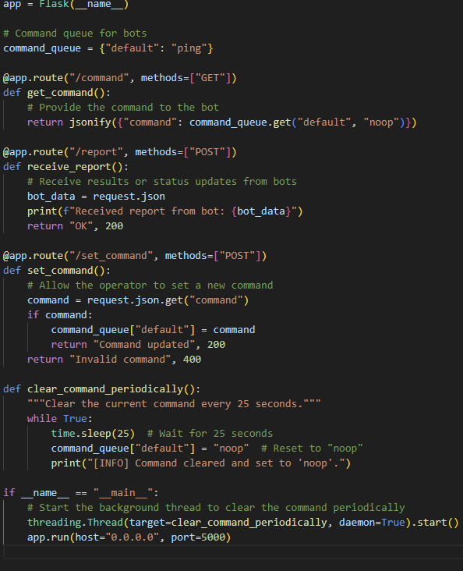
C2 – Server
Provides several paths through Flask that enable all previously discussed functionalities
Operator uses
/set_command
Bots use
/report and /command

Slide 17
Target
Simulated real world target
In this environment using a simple Python server that logs received HTTP, TCP, and UDP packets to the console.
Tries to decode the received data, as Bane will send traffic in many forms (e.g.: binary)
KeepAlive logging, ensuring the server is operational when not under attack.

Slide 18
Demo Workflow

Slide 19
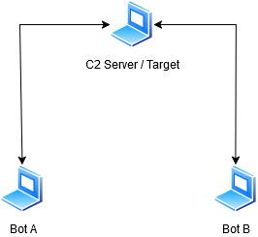
Demo workflow setup
All components were tested with strict adherence to safety and legal requirements. The tests were conducted entirely within a controlled local network, ensuring no disruption to real-world processes.
The setup involved three independent laptops on a local network due to complications with virtual machines. Additionally, the C2 server and target were hosted on the same machine due to hardware limitations. This configuration was effective and did not negatively impact the tests.

Slide 20
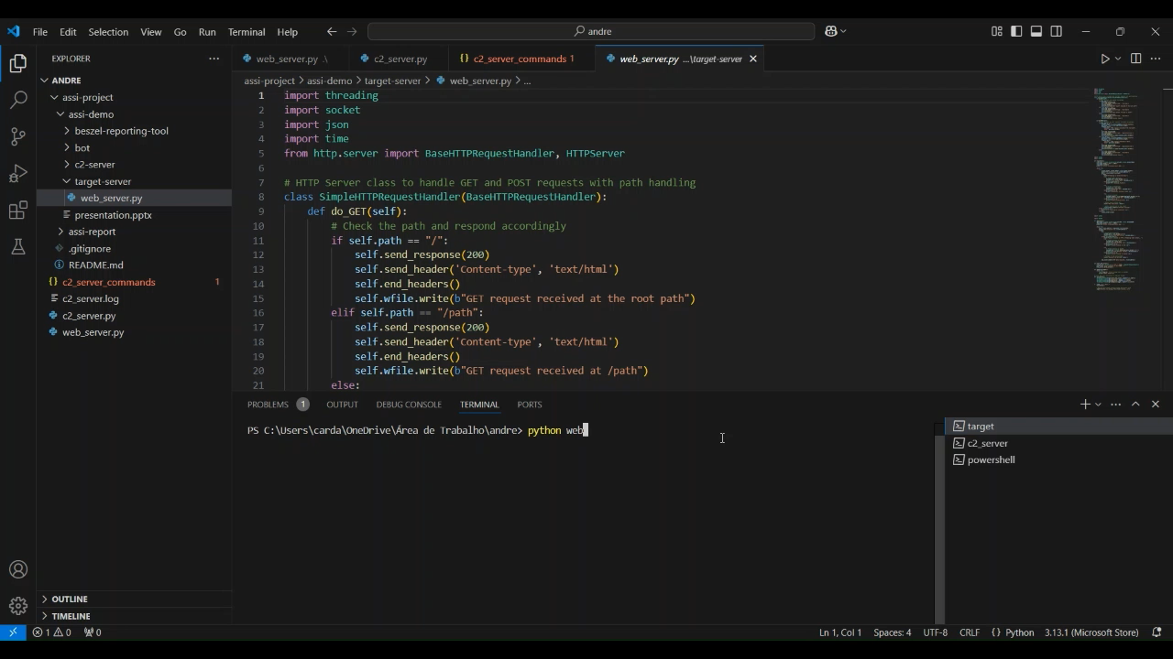
Target Device - Setup

Slide 21
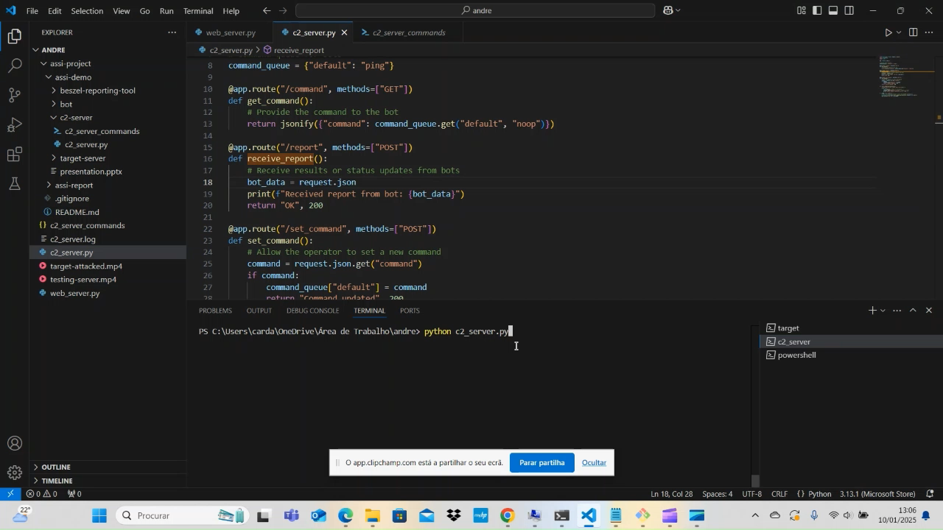
C2 Server / operator

Slide 22
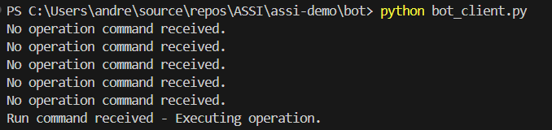
Bot Device
Receiving Command from C2
Sending Report to C2

Slide 23
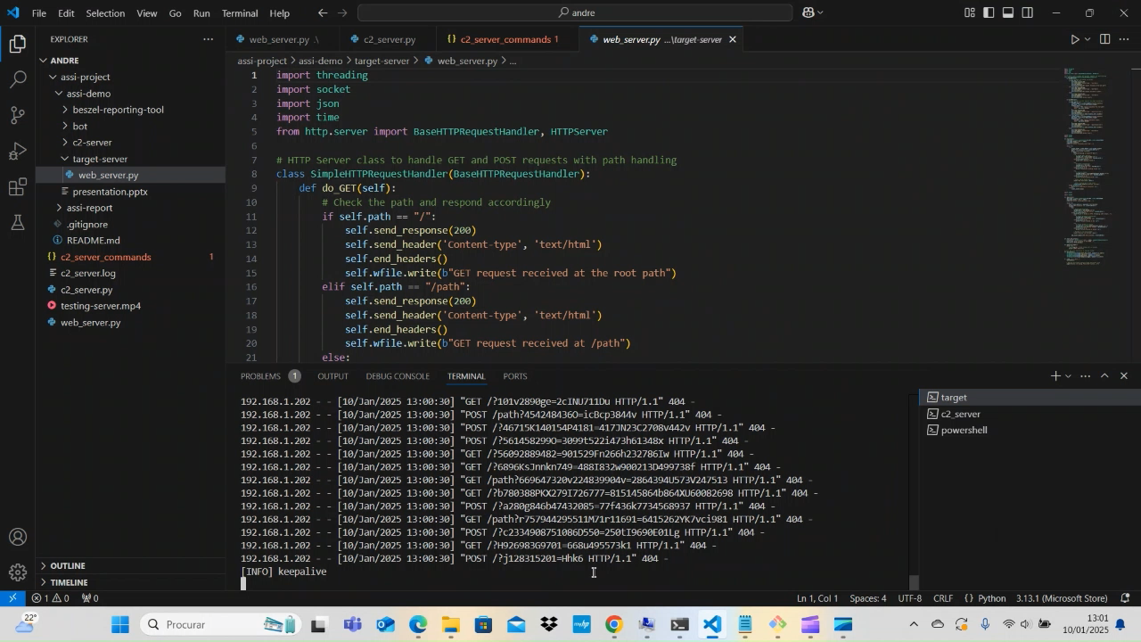
Target Device – Under Attack

Slide 24
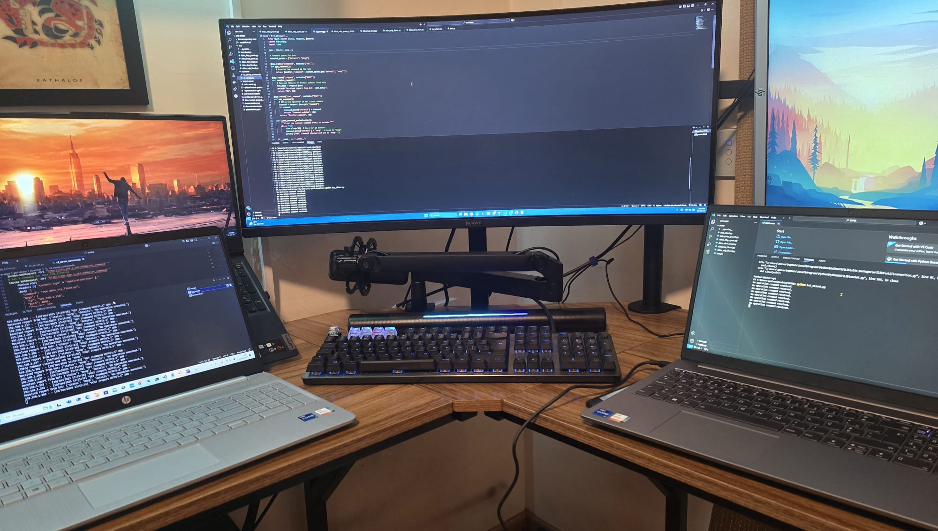
Environment SEtup
Left-most Laptop
C2 server / Target
Middle Laptop
Bot A
Right-most Laptop
Bot B

Slide 25
Data analysis
Metric Definitions
H_P = HTTP_PUNCH
H_S = HTTP_SPAM
T_F = TCP_FLOOD
U_F = UDP_FLOOD
S_R = SLOW_READ
NET = Approximate average Network Traffic per second
CPU = Approximate average CPU Usage
Attack Settings
Attacks done through the C2 server
Duration of 30 seconds
All machines running Windows 11
Only application open during attack was the command line
Idle (Control)
1 Bot Data Analysis
2 Bot Data Analysis
 | Idle
NET | 7Kb
CPU | 1.5%
 | H_P | H_S | T_F | U_F | S_R
NET | 6MB | 7MB | 1.3MB | 170Kb | 20Kb
CPU | 4% | 7.5% | 6% | 8% | 3%
 | H_P | H_S | T_F | U_F | S_R
NET | 8Mb | 9MB | 2MB | 200Kb | 30Kb
CPU | 5% | 9% | 7% | 13% | 3%

Slide 26
Conclusion
This project provides a structured framework to simulate, analyze, and understand botnet behaviors in a safe and controlled environment.
The key components—C2 Server, Bots, and Target—interact seamlessly to replicate real-world attack scenarios.
Finally, the data concluded that while the impact with 1 or 2 bots was minimal, the attack is highly scalable and can quickly become detrimental to the health of the server, as the attack's potency increases with the number of active bots.

Slide 27
THANK YOU
André Filho – 2240617
Ricardo Pereira - 2240619

